Slide 1
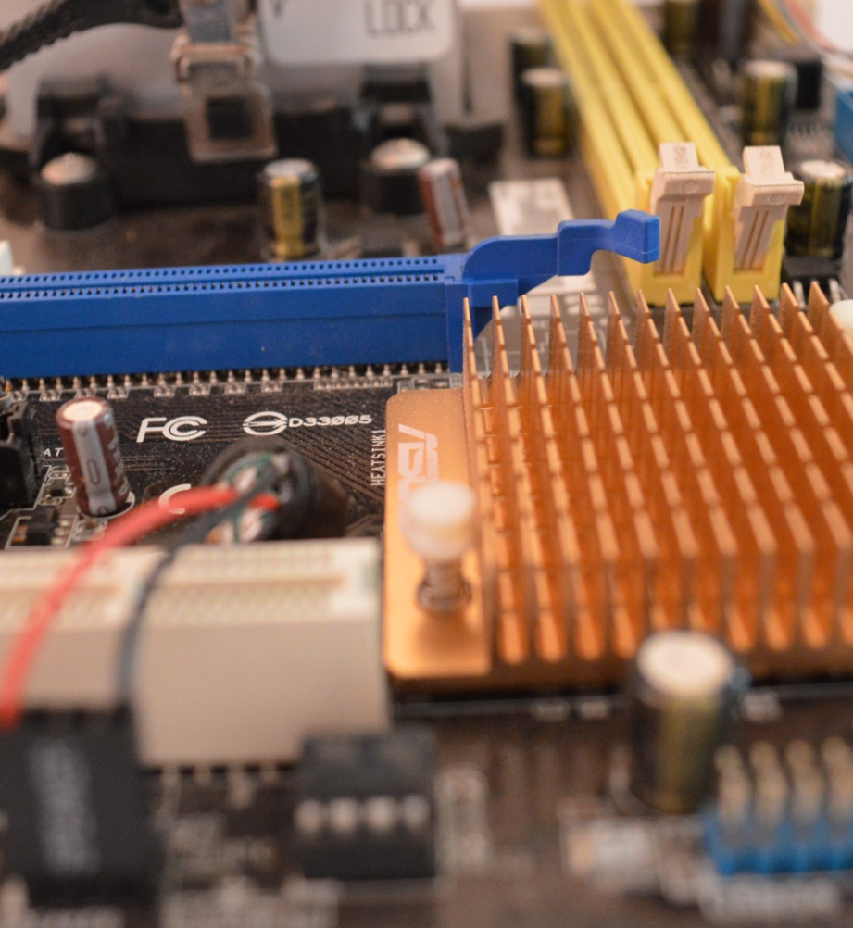
Computer Science
Transition workbook
The course is assessed by
2 exams (50% each exam)
The topic of Computer Science is at the heart of the modern world
Studying it can make you extremely sought after in todays job market
The transition from GCSE to A level is significant, this includes:
  An increased emphasis on technical content
  An increased emphasis independent research
This workbook is designed to allow you to practice some of these skills and build on your existing knowledge.
Please complete by your first lesson back in September.

Slide 2
1
“Tell me about yourself”
Why did you choose Computer Science?
Expected time to complete: ½ hour
In this simple task you get the opportunity to tell me your choices and reasons behind choosing to study Computer Science. Please answer all questions as best you can.
1. Why did you choose to study A level Computer Science?
2. What other courses have you chosen to study at Key Stage 5, and what made you choose this combination?
3. What are you hoping to achieve from studying Computer Science?
4. How would you describe yourself as a learner at GCSE? What skills where you good at, what areas would you like to improve on?
5. What are your other hobbies and interests outside of school? Anything related to Computing?
Notes:
This is an open-ended task, as such no model answers have been provided.

Slide 3
2
Independent research task
Emerging computer technology
Expected time to complete: 2 hours
In this task you get to investigate any area of emerging computer technology which interests you.
You can pick any area which interests you, but examples could be:
Artificial intelligence
Robotics
Automated self driving cards
Quantum computing
In no more than ONE side of A4 summarise the area you have chosen under the following four headings:
What is it?
What are the possible Social, Moral, Cultural and Ethical benefits of this technology on society
What are the possible Social, Moral, Cultural and Ethical risks of this technology on society
My conclusion on this technology and what it will mean for our world 10 years from now
Additional help:
For additional help and support in structuring your answer you might like to watch some of the videos from the following Craig ‘n’ Dave playlists:
OCR:
SLR 17 – Ethical, morale and cultural issues
https://student.craigndave.org/videos/slr-17-ethical-moral-and-cultural-issues
AQA:
SLR 19: Moral, social, legal, cultural issues
https://student.craigndave.org/videos/slr19-moral-social-legal-cultural-issues
Notes:
This is an open-ended task, as such no model answers have been provided.

Slide 4
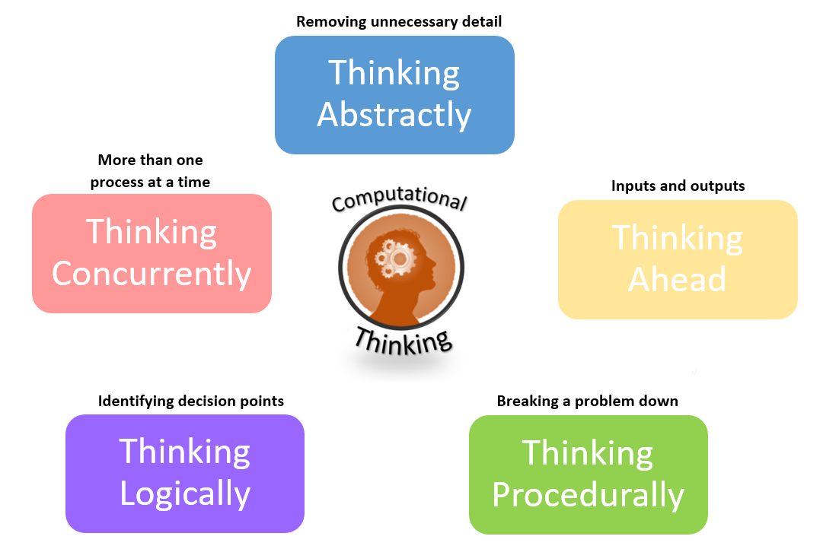
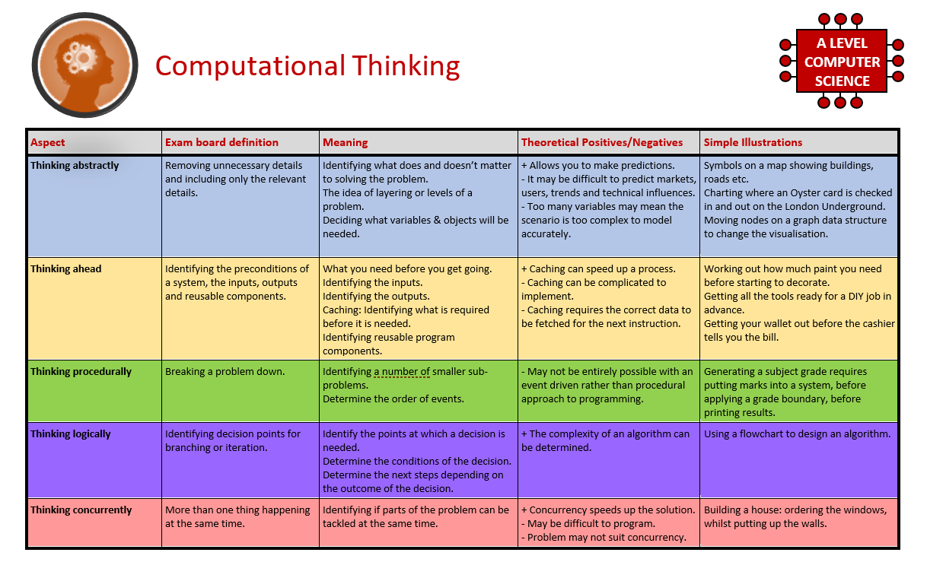
3
What is “computational thinking”?
Thinking like a computer
Expected time to complete: 2 hours
At the heart of Computer Science is the ability to look at problems, analyse them, break them down and solve them in a way which involves a variety of “Computational Thinking” skills.
Download the “Computational thinking and Computational methods placemats” from Craig n Dave:
  https://student.craigndave.org/specification-key-terminology-and-cheat-sheets
Create your own spider diagram / mind map which shows your clear understanding of the 5 different computational thinking strands
  Keep it to a single side of A4 / A3
Your goal is to imagine someone else has to revise from your mind map. Ask yourself:
  Does it make sense?
  Is it clear?
  Does it cover all of the important concepts?
Note:
Although the five strands listed (and the download resources provided for this task) are from the OCR AS / A’Level specification, the concepts of “Computational Thinking” are just as applicable to the AQA course.
Indeed many of the strands listed are explicitly covered in the AQA specification in different locations.
Notes:
This is an open-ended task, as such no model answers have been provided.

Slide 5
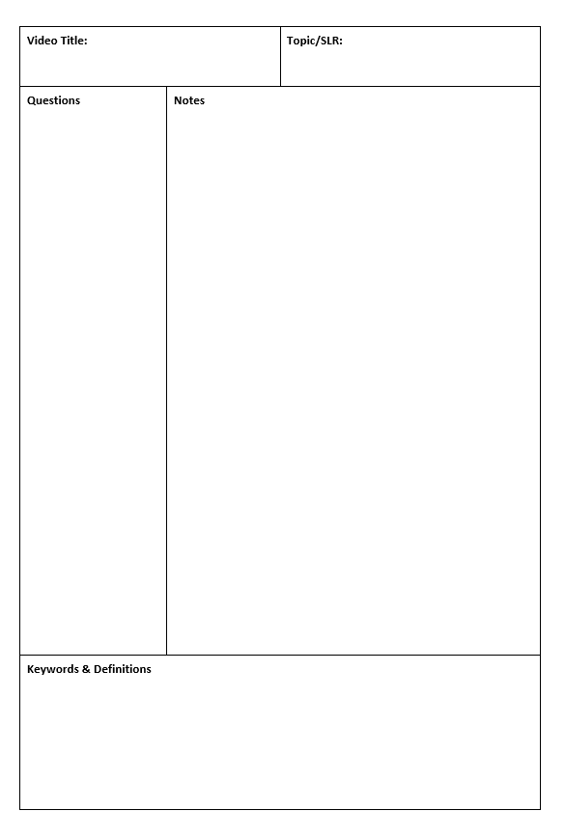
4
Note taking practice task
The Cornell method of note taking
Expected time to complete: 1½ hours
The expectation to do independent research at A Level will increase dramatically from GCSE.
There is a real skill to taking decent notes outside of lesson which are of value. Research has proven that one of the most effective methods is the “Cornell” note taking method.
To start download the “Cornell note taking template” from Craig n Dave:
  https://craigndave.org/product/cornell-note-taking-template/
Pick any two of the following videos from Craig ‘n’ Dave:
  AQA: https://student.craigndave.org/videos/aqa-alevel-slr06-procedural-functional-data-abstraction
  AQA: https://student.craigndave.org/videos/aqa-alevel-slr13-sample-resolution-and-rate
  AQA: https://student.craigndave.org/videos/aqa-alevel-slr13-encryption-vernam-cipher
  AQA: https://student.craigndave.org/videos/aqa-alevel-slr20-bit-rate-baud-rate-bandwidth-and-latency
  OCR: https://student.craigndave.org/videos/ocr-alevel-slr01-alu-cu-registers-and-buses
  OCR: https://student.craigndave.org/videos/ocr-alevel-slr04-paging-segmentation-and-virtual-memory
  OCR: https://student.craigndave.org/videos/ocr-alevel-slr05-stages-of-compilation
  OCR: https://student.craigndave.org/videos/ocr-alevel-slr14-data-structures-part-2-graphs
Write the title of the video and its topic in the top boxes (use a different sheet for each video).
In the main “Notes” section, write notes from the video. You can do this in any way you like, a suggestion might be to rewind slightly when the canvas changes, thinking carefully about what was important in the previous few minutes.
Having recorded the notes, review them:
  Turn each part into a question in the section on the left.
  For example, the notes may say, “The value of the program counter is passed to the memory address register”.
  The question then becomes, “which register is the value of the program counter passed to?”
  Sometimes these questions are easy, and at times they are more difficult to write.
  There may also be more than one valid question.
  You will need to decide for yourself which are the most appropriate questions for revision.
Finally pull out all the key words and their definitions words the notes and list them in the bottom section.
Notes:
This is an open-ended task, as such no model answers have been provided.

Slide 6
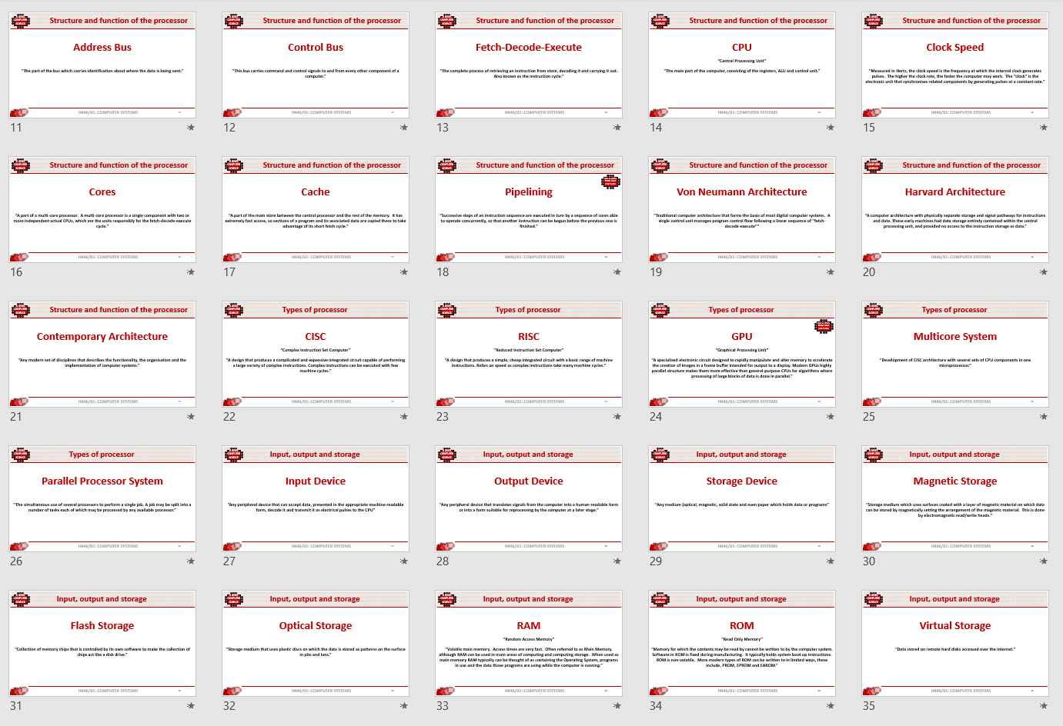
5
Key terms task
Getting to grips with terminology
Expected time to complete: 2 hours
An important aspect of being successful with your study of Computer Science is getting to grips with subject related terminology. There are over 240 specific terms you will need to learn!
Below are a handful of the key terms you will need to become familiar with.
Control Unit Register Busses
Von Neuman Architecture Optical Storage Operating System
Intermediate Code Device Driver Compiler
Assembly Language Machine Code Lossy Compression
Hashing Normalisation TCP/IP Stack
Packet Switching ASCII Problem Decomposition
Research each of the key terms and write a definition.
Resist the urge to simply cut and paste a definition off of the first website you find. Many definitions found on The Internet are overly complicated and wordy.
Ask yourself:
  Does my definition make sense?
  Is it succinct, to the point?
  Does the definition have appropriate depth and detail for A’Level?
  Could I give this definition to another student so they could revise from it?
Notes:
This is an open-ended task, as such no model answers have been provided.

Slide 7
5
Key terms task
Getting to grips with terminology
Expected time to complete: 2 hours
Term | Definition
Control Unit | “The part of the CPU that manages the execution of instructions. The control unit fetches each instruction in sequence, and decodes and synchronises it before executing it by sending control signals to other parts of the computer.”
Register | “Tiny areas of extremely fast memory located in the CPU normally designed for a specific purpose, where data or control information is stored temporarily.”
Busses | “A common physical pathway shared by signals to and from several components of a computer.”
Von Neuman Architecture | “Traditional computer architecture that forms the basis of most digital computer systems. A single control unit manages program control flow following a linear sequence of “fetch-decode-execute””
Optical Storage | “Storage medium that uses plastic discs on which the data is stored as patterns on the surface in pits and lands.”
Operating System | “Collection of systems software that manages the computer. Usually supplied with the computer. Most common operating systems are Windows, Linux, Unix, MacOS, iOS.”
Intermediate Code | “Half-way type of code which is standard across machine types. Runs on a virtual machine.”
Device Driver | “A computer program that operates or controls a particular type of device that is attached to a computer.”
Compiler | “A program that translates a high-level language program, source code, into a computer’s machine code.”
Notes:
Suggested model answer.
There are of course many acceptable definitions, so accept variations.

Slide 8
5
Key terms task
Getting to grips with terminology
Expected time to complete: 2 hours
Term | Definition
Assembly Language | “A language which is related very closely to the computer’s own machine code. ”
Machine Code | “Set of all possible instructions made available by the hardware design of a particular processor. Closest to pure binary.”
Lossy Compression | “A compression scheme where their generally involves a loss of resolution in parts of the image where experiences shows that it will be least noticed.”
Hashing | “The process of calculating a numeric value from one or more data items. While this value obviously depends on the value of the data items, it need not depend on the meaning attached to them, simply producing a number that is used within the computer.”
Normalisation | “The process of arranging data in tables and setting their relationships to move them through normal forms”
TCP/IP Stack | Transmission Control Protocol / Internet Protocol: “The most common general-purpose standard protocol that allows any networked computers (including those on The Internet) to communicate with each other whatever their equipment.”
Packet Switching | “A method of sending data over a wide area network in which the message is broken into a number of parts which are sent independently, over whatever route is optimum for each packet, and reassembled at the destination.”
ASCII | America Standard Code for Information Interchange: “A character set devised for early telecommunication systems but proved to be ideal for computer systems. ASCII codes use 7-bits giving 32 control codes and 96 displayable characters (the 8th bit is often used for error checking).”
Problem Decomposition | “The process by which a complex problem or system is broken down into parts that are easier to conceive, understand, program and maintain.”
Notes:
Suggested model answer.
There are of course many acceptable definitions, so accept variations.

Slide 9

6
An introduction to the basics of programming tasks
Programming basics
Expected time to complete: 6 hours
Learning to “code” is a fun and essential part of A Level Computer Science. This task is ideal if you haven't done the GCSE in Computer Science or you simply want a nice refresher ahead of starting your A Level course.
Head over to the web site: https://www.learnpython.org/
Complete the following python tutorials under the heading:
  • Hello, World!
  • Variables and Types
  • Lists
  • Basic Operators
  • String Formatting
  • Basic String Operations
  • Conditions
  • Loops
  • Functions
Each section presents you with theory, code to run and exercises to try out.
If you want to practice writing your own python programs you can download and install a simple python development tool here: https://www.python.org/downloads/
Additional note:
This task is most suited to students who intend to do the A Level and have not previously gained much / or any programming experience from the GCSE Computer Science course.
Although the language chosen here is Python, and that may not be what you will be using at A Level, it is the underlying programming concepts which are important.
The list of topics above cover the standard set of programming concepts you would be expected to know having completed a GCSE and Computer Science and so will prepare you well for the A level.
Notes:
This is an open-ended task, as such no model answers have been provided.

Slide 10
7
Critical thinking task
Why is Computer Science important?
Expected time to complete: 2 hours
It is easy to say, “Computer Science is essential in todays world”, but are you able to think critically about this statement and back it up? “Thinking Critically” is an essential skill at A Level.
It involves you:
Looking at a topic / concept in depth
Taking account of different views / perspectives
Considering positives and negatives
Evaluating links and effects on other concepts
Drawing your own conclusions backed up with evidence
On the following slide answer the questions:
  What is Computer Science?
  What are the benefits and risks of Computer Science at a local level (think about your local community / town / city / county)
  What are the benefits and risks of Computer Science at a national level
  What are the benefits and risks of Computer Science at a global level
Additional help:
For additional help and support in structuring your answer you might like to watch some of the videos from the following Craig ‘n’ Dave playlists:
OCR:
SLR 17 – Ethical, morale and cultural issues
https://student.craigndave.org/videos/slr-17-ethical-moral-and-cultural-issues
AQA:
SLR 19: Moral, social, legal, cultural issues
https://student.craigndave.org/videos/slr19-moral-social-legal-cultural-issues
Notes:
This is an open-ended task, as such no model answers have been provided.

Slide 11
7
Critical thinking task
Why is Computer Science important?
Expected time to complete: 2 hours
What is Computer Science?
Enter your answer here
What are the benefits and risks of Computer Science at a local level
Enter your answer here
Try to make at least 4 valid points
What are the benefits and risks of Computer Science at a national level
Enter your answer here
At least 2 of your points should be about the potential risks of Computer Science
At least 2 of your points should be about the potential benefits of Computer Science
Try to make at least 4 valid points
At least 2 of your points should be about the potential risks of Computer Science
At least 2 of your points should be about the potential benefits of Computer Science
What are the benefits and risks of Computer Science at a global level
Enter your answer here
Try to make at least 4 valid points
At least 2 of your points should be about the potential risks of Computer Science
At least 2 of your points should be about the potential benefits of Computer Science
Notes:
This is an open-ended task, as such no model answers have been provided.

Slide 12
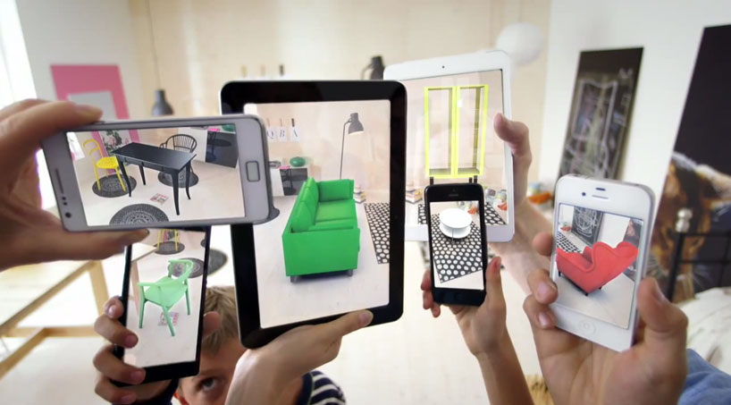
8
Applying technical knowledge in context task
Augmented reality
Expected time to complete: 1½ hours
A key skill at A Level is being able to take a topic and then discuss it in the context of different scenarios.
Most theory-based exam questions will be asked in the form of a scenario, simply regurgitating what you know on the topic without contextualising your answer to the scenario will often result in low marks!
The topic for this exercise is “Augmented Reality”. It is a truly fascinating area of technology which has the potential to change almost every aspect of our daily lives.
Watch this brief video to learn more: https://www.youtube.com/watch?v=vQtwWzfzKXI
After watching the video complete the next slide which asks you to discuss the benefits, limitations and risks of augmented reality in the context of:
Medicine & health care
Gaming & entertainment
Schools & learning
Travel & tourism
Social media
Transport & navigation
Image by Oyundari Zorigtbaatar (20 March 2016) https://creativecommons.org/licenses/by-sa/4.0/legalcode
Notes:
This is an open-ended task, as such no model answers have been provided.

Slide 13
8
Applying technical knowledge in context task
Augmented reality
Expected time to complete: 1½ hours
Medicine & health care
Discuss the benefits, limitations and risks of augmented reality in this context:
Enter your answer here
Gaming & entertainment
Discuss the benefits, limitations and risks of augmented reality in this context:
Enter your answer here
Schools & learning
Discuss the benefits, limitations and risks of augmented reality in this context:
Enter your answer here
Travel & tourism
Social media
Transport & navigation
Enter your answer here
Discuss the benefits, limitations and risks of augmented reality in this context:
Discuss the benefits, limitations and risks of augmented reality in this context:
Enter your answer here
Discuss the benefits, limitations and risks of augmented reality in this context:
Enter your answer here
Notes:
This is an open-ended task, as such no model answers have been provided.

Slide 14
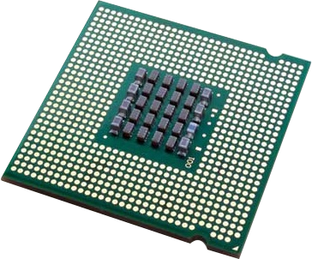
9
Systems architecture task
Looking under the hood of the processor
Expected time to complete: 2 hours
The CPU “Central Processing Unit” is the central core of any computer system. You will study what it contains and how it works it in depth at A Level.
Start by watching the following 3 videos from Craig ‘n’ Dave (choose from OCR or AQA exam board)
  OCR: https://student.craigndave.org/videos/ocr-alevel-slr01-alu-cu-registers-and-buses
  OCR: https://student.craigndave.org/videos/ocr-alevel-slr01-fetch-decode-execute-cycle
  OCR: https://student.craigndave.org/videos/ocr-alevel-slr01-performance-of-the-cpu
  AQA: https://student.craigndave.org/videos/aqa-alevel-slr17-the-processor-and-its-major-components
  AQA: https://student.craigndave.org/videos/aqa-alevel-slr17-alu-cu-registers-and-buses
  AQA: https://student.craigndave.org/videos/aqa-alevel-slr17-performance-of-the-cpu
Produce a fully annotated diagram on a single sheet of A4 / A3 paper which shows how the CPU works.
Make sure the diagram includes and covers:
  Major CPU components and what they are for:
    Arithmetic Logic Unit (ALU)
    Control Unit (CU)
    Cache
  The main registers
    Program Counter (PC)
    Memory Address Register (MAR)
    Current Instruction Register (CIR)
    Memory Data/Buffer Register (MDR / MBR)
  Fetch-decode-execute cycle
  Include annotations which explain how the performance of a CPU can be improved by:
    Increasing the clock speed
    Increasing the cache size
    Increasing the number of cores

Slide 15
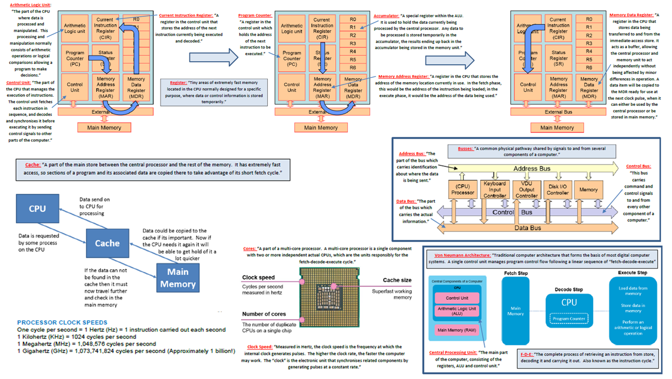
9
Systems architecture task
Looking under the hood of the processor
Expected time to complete: 2 hours
Notes:
Suggested model answer.
There are of course many acceptable variations a student could produce.

Slide 16
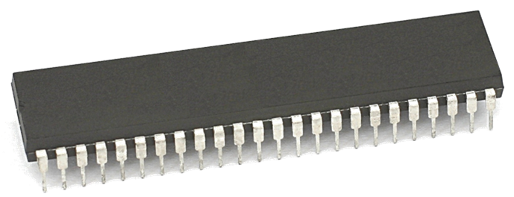
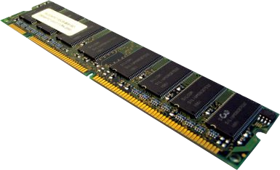
10
Memory task
Different types of memory
Expected time to complete: 1 hour
Computer memory comes in many different forms, some of the main ones are:
Random Access Memory (RAM)
Read Only Memory (ROM)
Virtual Memory
Carry out some research into these forms of memory and then complete the tasks on the following slide.
Additional help:
For additional help and support in completing this task you might like to watch some of the following videos from Craig ‘n’ Dave:
RAM and ROM:
https://student.craigndave.org/videos/ocr-gcse-slr1-2-ram-and-rom
The need for Virtual Memory:
https://student.craigndave.org/videos/ocr-gcse-slr1-2-the-need-for-virtual-memory

Slide 17
10
Memory task
Different types of memory
Expected time to complete: 1 hour
Random Access Memory (RAM)
A form of primary storage used to store instructions and data which need to be used by the CPU while a computer is in operation.
Read Only Memory (ROM)
A form of primary storage which contains essential instructions on who to start up a computer, often written at manufacturing time.
Virtual Memory
Using part of the hard disk or other secondary storage device as if it where main memory (RAM).
This allows for more applications to be open and running than physical main memory could normally hold.
Readable and writable
Typically holds the part of the operating system currently in use, applications being used, the data those applications are using.
Volatile
Non-volatile
Read only
Initial instructions your computing first needs when booting up, known as the Bootstrap.
Notes:
Suggested model answer.
Accept other sensible variations.

Slide 18

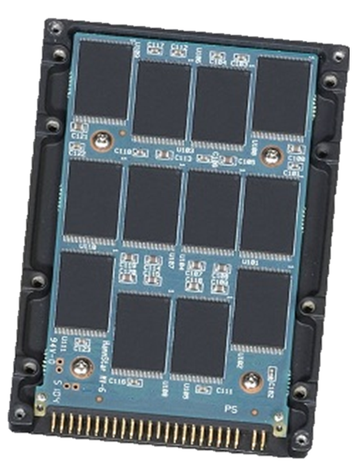

11
Storage task
Types of secondary storage
Expected time to complete: 1 hour
Virtually all secondary storage devices in use today fit into one of three broad categories:
Magnetic
Optical
Solid state
Carry out some research into these categories and then complete the tasks on the following slide.
Additional help:
For additional help and support in completing this task you might like to watch some of the following videos from Craig ‘n’ Dave:
Magnetic, Flash and Optical storage:
https://student.craigndave.org/videos/ocr-alevel-slr03-magnetic-flash-and-optical-storage
Comparing capacity and speed of storage media:
https://student.craigndave.org/videos/aqa-alevel-slr18-comparing-capacity-and-speed-of-storage-media

Slide 19
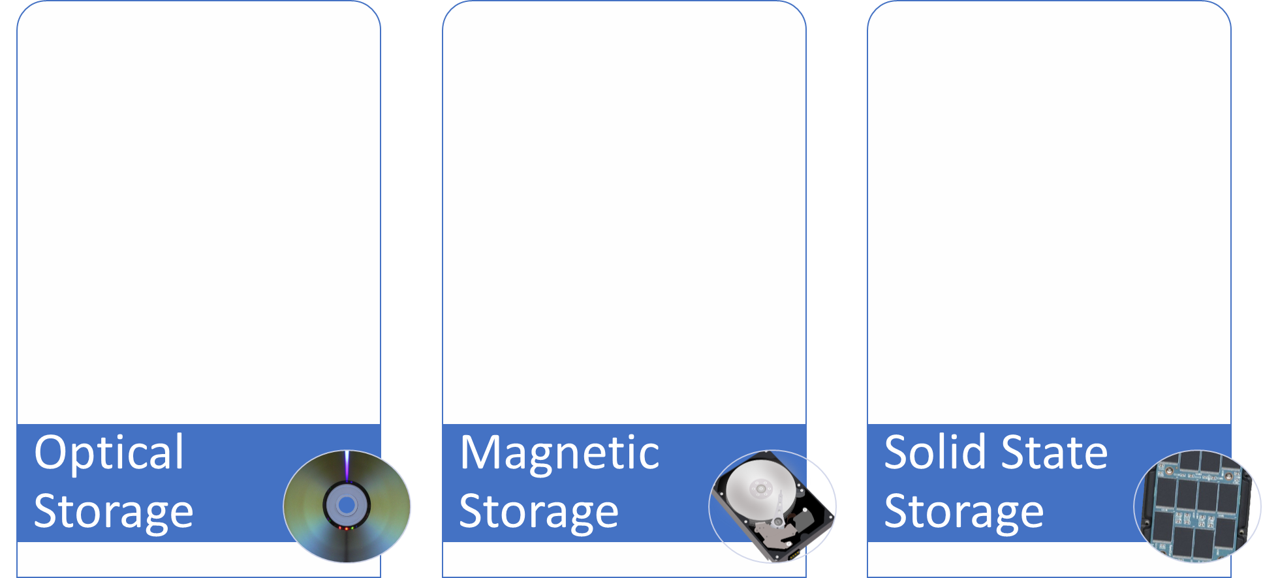
11
Storage task
Types of secondary storage
Expected time to complete: 1 hour
How does it work?
How does it work?
How does it work?
For read only optical storage it stores information in pits and lands which are burnt into disc when it is created. A laser passes over the surfer and at the point when the pits start or end it causes the laser light to scatter. This change in reflection is interrupted as 0’s and 1’s
Uses magnetic fields to store 0’s and 1’s.
A drive head physically moves over the surface of a hard drive platter reading the different magnetic fields.
A flow of electricity forces electrons into floating gates between two oxide layers. This causes a change in the charge in the floating gate and this can be measured as a 0 or a 1.
Advantages / Positives
Advantages / Positives
Advantages / Positives
Cheap to produce
Light weight
Highly portable
Very cheap to produce
Very large capacity
Durable as it has no moving parts, can cope with knocks and bumps
Fast access times
Disadvantages / Negatives
Disadvantages / Negatives
Disadvantages / Negatives
Slow access times compared to other forms of storage
Prone to scratches
Slow access times as the platters have to spin up to speed and the drive head needs to move to read/write data.
Fragile as it is made of so many intricate moving parts.
Currently the most costly of the three types of storage Mb for Mb, though costs are coming down all the time.
Has a limited number of read / write’s
Examples of typical usage
Examples of typical usage
Examples of typical usage
Multimedia files, e.g. audio, files etc.
Sometimes used for backup and archiving
Large mass storage of data, applications and system files
Good for off site backup
Large mass storage of data, applications and system files
Good for off site backup
Typical storage capacity range
Typical storage capacity range
Typical storage capacity range
CD 720MB~ DVD 4.7-17 GB~ Blu-ray 25GB-128GB~
Typically anywhere from 500GB – 10TB and increasing
Typically anywhere from 250GB – 4TB and increasing
Notes:
Suggested model answer.
Accept other sensible variations.

Slide 20










12
Networks task
Types of networks
Expected time to complete: 2 hours
Use the following symbols:
Carry out some research on computer networks, in particular LANs, WiFi, Network topologies and connectivity devices.
Use the symbols on the right (feel free to revise them) to create an appropriate network over the floorplan on the next slide.
Make sure your network meets all the following requirements:
Each member of the main office needs a desktop PC
Angela, Pam, Dwight and Oscar also use an office issued smart phone
The following rooms new access to WiFi:
  Meeting room (top right)
  Reception
  Conference Room
  Main office
Use a circle with a transparent fill (so you can see the network underneath) with a width and height of 12.5cm to provide the WiFi coverage needed to cover the rooms above:
  The circles need to have a WAP at the centre
  The 12.5cm diameter circles represent the maximum range of each WAP
  They WAP icons must be attached to a wall
  You must use the minimum number of WAP possible to provide the coverage needed
All desktop PCs use wired connections in a star network configuration
  The top left server room, conference room and main office need to be on one subnet with its own switch
  All other rooms are on a separate subnet and will require its own hardware for this
  The two subnets need to be appropriately connected together
The top left room needs to have a server placed in it and connected appropriately to the local subnet
The server room needs hardware to appropriately connected the LAN to “The Internet”
Reception needs a photocopier and it needs connecting to the local subnet
A firewall should be placed somewhere appropriate
Desktop PC
Tablet
Phone
Router
WAP
Switch
Firewall
Server
Photocopier
Indicates a wireless enabled device
Additional help:
For additional help and support in structuring your answer you might like to watch some of the videos from the following Craig ‘n’ Dave playlists:
OCR: SLR 11 – Networks
https://student.craigndave.org/videos/slr-11-networks
AQA: SLR21 – Network and the Internet
https://student.craigndave.org/videos/slr21-networks-the-internet

Slide 21
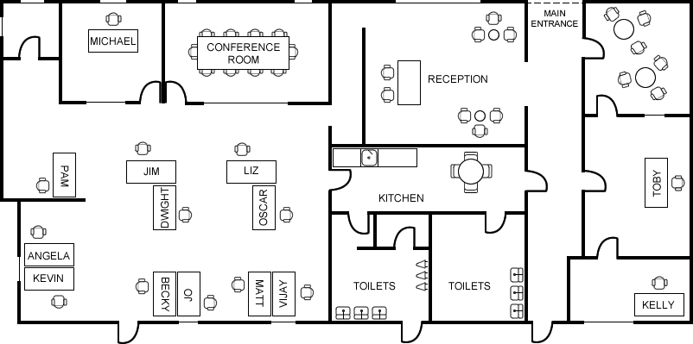
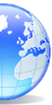


12
Networks task
Types of networks
Expected time to complete: 2 hours
Internet
Accept other sensible configurations which meet the requirements.
Notes:
Suggested model answer.
Accept other sensible variations.

Slide 22


13
Systems software task
Operating systems
Expected time to complete: 2 hours
Operating systems are arguably the most important piece of software installed on a computer.
Carry out some research into the following areas:
The purpose of operating systems
The roles of operating systems
The purpose of interrupts
How interrupts work as part of the fetch-decode-execute cycle
Complete the tasks on the following slides.
Additional help:
For additional help and support in structuring your answer you might like to watch some of the videos from the following Craig ‘n’ Dave playlists:
OCR: SLR 4 – Operating systems – Systems software
https://student.craigndave.org/videos/slr-4-operating-systems-systems-software
AQA: SLR14 – Hardware & software
https://student.craigndave.org/videos/slr14-hardware-software

Slide 23
13
Systems software task
Operating systems
Expected time to complete: 2 hours
List at least 8 different roles an Operating System perform.
The purpose and roles of an Operating System
Managing hardware
Managing memory
Managing installed programs and those being run
Managing systems security
Providing an interface between the user and the computer
Managing the processor
Handling input / output from external peripherals
Managing networking
Notes:
Suggested model answer.
Accept other sensible variations.

Slide 24
13
Systems software task
Operating systems
Expected time to complete: 2 hours
Rearrange the elements in the diagram below to show hoe the fetch-decode-execute cycle handles interrupts.
No
Fetch next instruction
Decode instruction
Execute instruction
Any higher priority interrupts to be processed?
Yes
No
Put registers on the memory stack
Interrupt service routine loaded
Fetch next instruction
Decode instruction
Execute instruction
Any higher priority interrupts to be processed?
Pop registers off the memory stack
When interrupt code complete
Yes
As above
Notes:
Suggested model answer.
Accept other sensible variations.

Slide 25
13
Systems software task
Operating systems
Expected time to complete: 2 hours
Drag the labels into their correct place on the following diagram:
Explain what this diagram is showing:
User
Applications
Operating System
Hardware
The operating system is a layer of software between the applications and the hardware.
It manages open applications, providing a user interface, multi-tasking, security and memory management.
It provides a mechanism for the applications to use the hardware, sending outputs to the device drivers, and receiving input from the devices.
The complexity of storing, retrieving, inputting and outputting to the hardware is transparent to the user.
Notes:
Suggested model answer.
Accept other sensible variations.

Slide 26
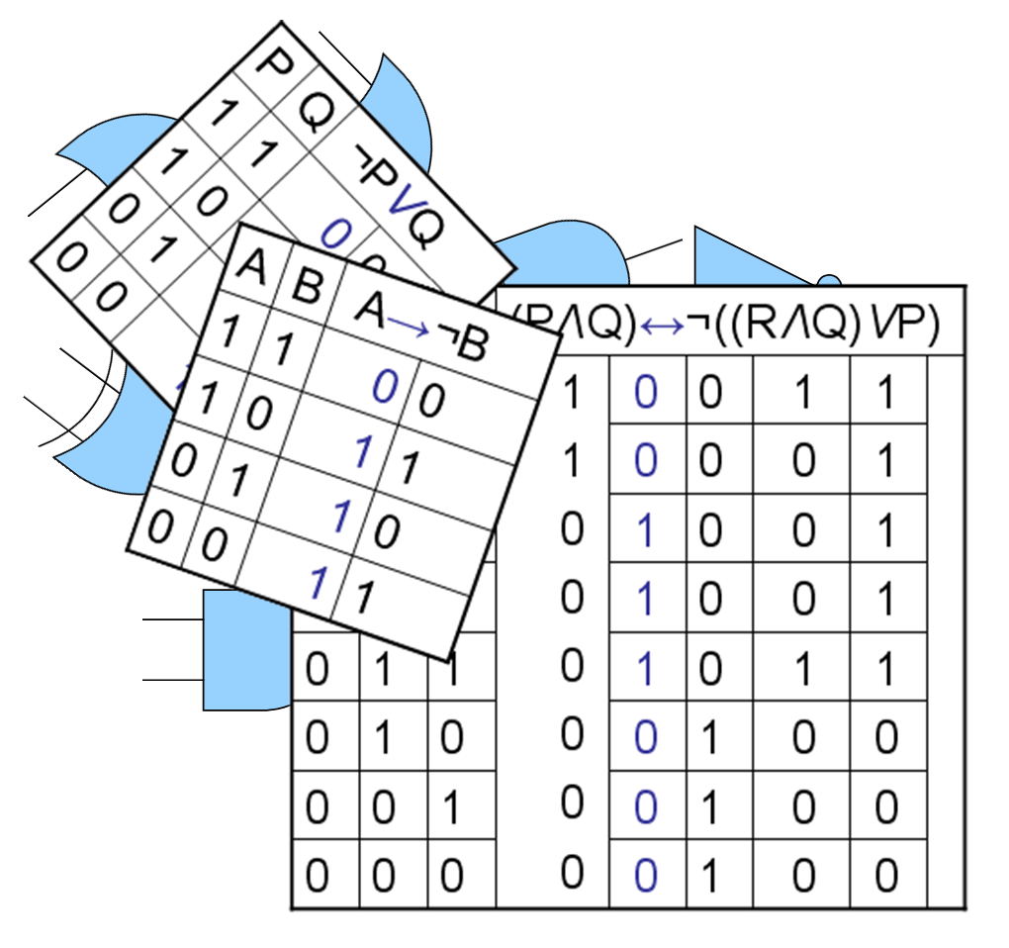
14
Computational logic task
Truth tables to circuit diagrams
Expected time to complete: 2 hours
An important area of computer science is understanding the logic gates and diagrams which are used to represent the physical circuitry of computer systems.
Carry out some research into the following areas:
Logic gates:
  AND
  NAND
  NOR
  NOT
  OR
  XOR
Truth tables
Boolean expressions
Circuit diagrams
Complete the tasks on the following slides.
Additional help:
For additional help and support in structuring your answer you might like to watch some of the videos from the following Craig ‘n’ Dave playlists:
OCR: SLR 15 – Boolean algebra
https://student.craigndave.org/videos/slr-15-boolean-algebra
AQA: SLR16 – Logic gates & Boolean algebra
https://student.craigndave.org/videos/slr16-logic-gates-boolean-algebra
Notes:
Suggested model answer.
Accept other sensible variations.

Slide 27
14
Computational logic task
Truth tables to circuit diagrams
Expected time to complete: 2 hours
Drag the labels into their correct place on the following diagram:
AND
NOT
NAND
OR
NOR
XOR
Notes:
Model answer.

Slide 28
14
Computational logic task
Truth tables to circuit diagrams
Expected time to complete: 2 hours
Draw the circuit diagram which would represent the following Boolean expression:
AQA Boolean Expression: F = (A B) ● C
OCR Boolean Expression: F = ¬(¬C ∧ (A V B)
Complete the truth table for the circuit diagram you have drawn
A | B | C | D | E | F
0 | 0 | 0 | 0 | 1 | 1
0 | 0 | 1 | 0 | 0 | 1
0 | 1 | 0 | 1 | 1 | 0
0 | 1 | 1 | 1 | 0 | 1
1 | 0 | 0 | 1 | 1 | 0
1 | 0 | 1 | 1 | 0 | 1
1 | 1 | 0 | 0 | 1 | 1
1 | 1 | 1 | 0 | 0 | 1
A
XOR
B
D
NAND
F
E
C
NOT
Notes:
Model answer.

Slide 29

15
Binary task
Representing negative numbers in binary
Expected time to complete: 1½ hours
In GCSE computer science you will have learnt how to represent positive whole numbers in binary e.g. 47
At A Level you will need to know how to represent negative as well e.g. -47
Start to recapping (or learning if you didn’t do the GCSE) how to represent positive whole numbers between 0-255 in binary
Now research how to represent negative numbers in binary using the method known as:
Two’s complement
Complete the tasks on the following slides.
Additional help:
For additional help and support in structuring your answer you might like to watch some of the following videos from Craig ‘n’ Dave:
GCSE recap: How to represent positive binary values 0-255
https://student.craigndave.org/videos/aqa-gcse-slr13-number-bases
A Level: Representing negative binary values using Two’s Complement
https://student.craigndave.org/videos/aqa-alevel-slr11-twos-complement

Slide 30
15
Binary task
Representing negative numbers in binary
Expected time to complete: 1½ hours
Write out the positive binary number 107, the answer should be displayed in 8 bits.
How would you represent the lowest negative number possible using Two’s Complement, given 8 bits.
128 | 64 | 32 | 16 | 8 | 4 | 2 | 1
0 | 1 | 1 | 0 | 1 | 0 | 1 | 1
Binary weighting
-128 | 64 | 32 | 16 | 8 | 4 | 2 | 1
1 | 0 | 0 | 0 | 0 | 0 | 0 | 0
Binary weighting
Binary value
Binary value
64 + 32 + 8 + 2 + 1 = 107
Write out the negative binary number -107 using Two’s Complement, the answer should be displayed in 8 bits.
How would you represent the largest positive number possible using Two’s Complement, given 8 bits.
-128 | 64 | 32 | 16 | 8 | 4 | 2 | 1
1 | 0 | 0 | 1 | 0 | 1 | 0 | 1
Binary weighting
-128 | 64 | 32 | 16 | 8 | 4 | 2 | 1
0 | 1 | 1 | 1 | 1 | 1 | 1 | 1
Binary weighting
Binary value
Binary value
-128 + 16 + 4 + 1 = -107
Notes:
Model answer.

Slide 31
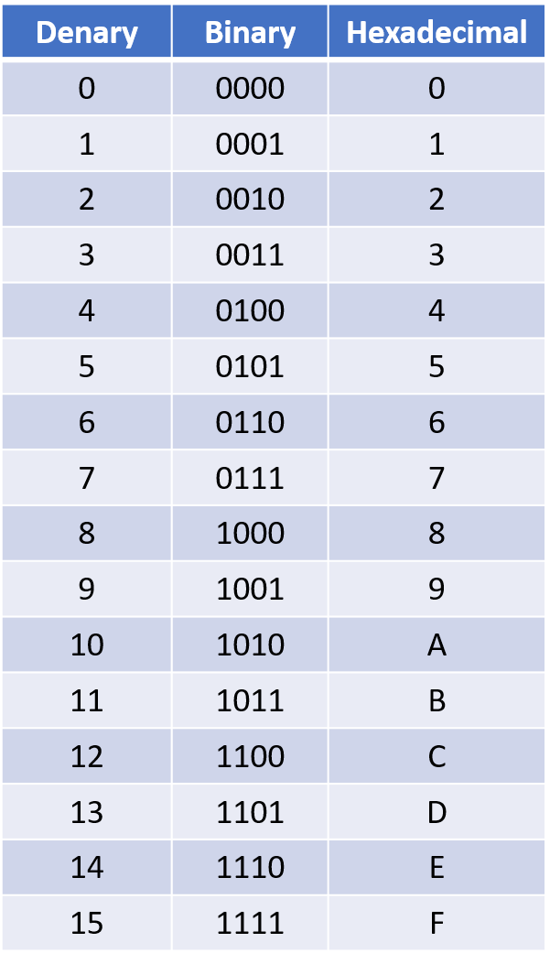
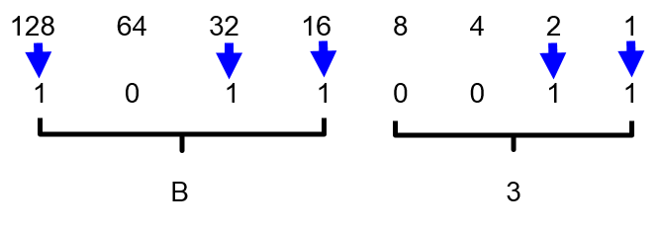
16
Binary task
Converting between base-2, base-10 and base-16
Expected time to complete: 1½ hours
As humans we have use the decimal or denary number system (base-10), made up of the unique digits 0-9.
Computer systems at the most basic level use only binary 1’s and 0’s (base-2).
As a computer scientist you will also need to become familiar with the hexadecimal number system (base-16).
You will also need to be comfortable with converting numbers between these three base systems.
Research the following areas:
Base-2 binary number system
Base-10 decimal/denary number system
Base-16 hexadecimal number system
How to convert between base-2, base-10 and base-16
Complete the tasks on the following slides.
Additional help:
For additional help and support in structuring your answer you might like to watch some of the following videos from Craig ‘n’ Dave:
Base 2, 10 and 16 number systems:
https://student.craigndave.org/videos/aqa-alevel-slr10-base-2-10-and-16-number-systems
Converting between binary, hex and decimal:
https://student.craigndave.org/videos/aqa-alevel-slr11-aqa-converting-between-binary-hex-and-decimal

Slide 32
16
Binary task
Converting between base-2, base-10 and base-16
Expected time to complete: 1½ hours
Convert the base-2 binary number 11000101 into base-10 and base-16.
(Show all your working)
Convert the base-16 hexadecimal number 9F into base-2 and base-10.
(Show all your working)
128 | 64 | 32 | 16 | 8 | 4 | 2 | 1
1 | 1 | 0 | 0 | 0 | 1 | 0 | 1
Binary weighting
9
F
Binary value
8 | 4 | 2 | 1 | 8 | 4 | 2 | 1
1 | 0 | 0 | 1 | 1 | 1 | 1 | 1
Binary weighting
128 + 64 + 4 + 1 = 197
Binary value
8 | 4 | 2 | 1 | 8 | 4 | 2 | 1
1 | 1 | 0 | 0 | 0 | 1 | 0 | 1
8 + 1=9
8 + 4 + 2 + 1=15
128 | 64 | 32 | 16 | 8 | 4 | 2 | 1
1 | 0 | 0 | 1 | 1 | 1 | 1 | 1
Binary weighting
8 + 4 = 12
4 + 1 = 5
Binary value
C
5
128 + 16 + 8 + 4 + 2 + 1 = 159
Notes:
Model answer

Slide 33

17
Linear search programming task
Algorithms: from theory to practice
Expected time to complete: 4 hours
A core concept of computer science is that of data structures and algorithms.
It is also an area which many students struggle with during examinations.
Probably the most basic algorithm is that of the “linear search”.
If you have done the GCSE course you will have learnt about this searching algorithm already.
Start by learning or refreshing your knowledge of the linear search algorithm by using the videos on this page:
https://www.craigndave.org/algorithms-linear-search
Once you are happy with the theory complete the exercises on the following slides.

Slide 34
17
Linear search programming task
Algorithms: from theory to practice
Expected time to complete: 2 hours
Describe what the linear search algorithm does.
The linear search finds an item in a sorted or unsorted list.
To perform a linear search, start at the first item in the list and check each item one by one.
Think about searching for a card in a shuffled deck, starting with the top card and checking each one until you find the card you want.
What are the applications of the linear search algorithm,?
The linear search is ideal for finding items in small data sets and performing searches with unordered data such as settings files.
It is the easiest searching algorithm to implement but usually the most inefficient.
Write out the steps of the linear search algorithm in simple-structured English.
Start at the first item in the list.
If the item in the list is the one to be found, the search is complete.
If it is not, move to the next item.
Repeat from step 2 until the item is found or there are no more items in the list.
If the item has been found, output item data. If it has not, output “not found.”
Draw a simple diagram which illustrates the linear search algorithm.
Notes:
Model answer

Slide 35
17
Linear search programming task
Algorithms: from theory to practice
Expected time to complete: 2 hours
Write out pseudocode for the linear search algorithm.
The algorithm should use an array called items which is pre-populated with the following values: "Florida","Georgia","Delaware","Alabama","California“
The algorithm should ask the user to “Enter the state to find:”
If the algorithm locates the state entered by the user in the array it should report back to the screen “Item found at position n”
If the algorithms can not locate the state entered by the user in the array it should report back to the screen “Item not found”
items = ["Florida","Georgia","Delaware","Alabama","California"]
item_to_find = input("Enter the state to find: ")
index = 0
found = False
While found == False and index < items.Length
If items[index] == item_to_find then
found = True
Else
index = index + 1
End If
End while
If found == True then
Print "Item found at position ",index
Else
Print "Item not found"
End If
Notes:
Model answer

Slide 36
17
Linear search programming task
Algorithms: from theory to practice
Expected time to complete: 2 hours
Have a go at coding the linear searching algorithm in a programming language of your choice.
The program should work use an array called items which is pre-populated with the following values: "Florida","Georgia","Delaware","Alabama","California“
The program should ask the user to “Enter the state to find:”
If the program locates the state entered by the user in the array it should report back to the screen “Item found at position n”
If the program can not locate the state entered by the user in the array it should report back to the screen “Item not found”
Coded solution in Python:
Coded solution in Visual Basic:
items = ["Florida","Georgia","Delaware","Alabama","California"]
item_to_find = input("Enter the state to find: ")
index = 0
found = False
while found == False and index < len(items):
if items[index] == item_to_find:
found = True
else:
index = index + 1
if found == True:
print ("Item found at position",index)
else:
print ("Item not found")
Dim items() As String = {"Florida", "California", "Delaware", "Alabama", "Georgia"}
Dim item_to_find As String
Dim index As Integer = 0
Dim found As Boolean = False
Console.WriteLine("Enter the state to find: ")
item_to_find = Console.ReadLine
Do While found = False And index < items.Count
If items(index) = item_to_find Then
found = True
Else
index = index + 1
End If
Loop
If found = True Then
Console.WriteLine("Item found at position " & index)
Else
Console.WriteLine("Item not found")
End If
Console.ReadLine()
Notes:
Model answer

