Slide 1
Sally Merrell
Student Recruitment Manager
Email: apprenticeships@mmu.ac.uk
Twitter: @MMUapprentice
Facebook: @MMUapprenticeships

Slide 2
DIFFERENT LEVELS OF APPRENTICESHIPS
Level | Apprenticeship Type | Entry Requirements | Qualification Equivalents
Level 6 | Degree | University requirements | Bachelor’s degree
Level 5 | Higher | 5 x GCSEs + Level 3 (A Level, BTEC) | Years 1 – 2 of degree Foundation degree HNC, HND
Level 4
Level 3 | Advanced | 5 x GCSEs | A Levels BTEC Level 3 Diploma NVQ Level 3
Level 2 | Intermediate | 2 x GCSEs | GCSE grades 4 – 9 BTEC Level 2 Cert/Dip NVQ Level 2

Slide 3
WHAT ARE DEGREE APPRENTICESHIPS?
+
Full-time employment
Full honours degree
BA/BSc/BEng
Notes:
80% work, 20% university including independent study time
Full time job – for those who are ready for working life and full-time employment but still want a valuable degree level qualification.

Slide 4
WHAT ARE DEGREE APPRENTICESHIPS?
COMMON SUBJECT AREAS
Typically
4
year programmes
Building and Surveying
Finance
Policing
Paralegal & Solicitor
104 - 112
UCAS points
Construction
Food Technology
Health Care & Nursing
Engineering
GCSE English and Maths grade C/4
Business & Management
Chemical Science
Digital Marketing
Digital & Technology
Notes:
Manchester Met – doesn’t offer all of these, this is what is out there in general for sixth form/college leavers with some newer recent additions in the creative industries
Explain what UCAS points equate to in A Levels/BTEC grades

Slide 5
BENEFITS OF DEGREE APPRENTICESHIPS
No tuition fees
A paid salary
Significant employment experience
Contextualises learning
Opportunities for fast career progression
Notes:
Tuition paid by apprenticeship levy, gov funding
Salary, currently £14,000 a year minimum (Sept 22) – average around £17,000 a year with some companies up to £22,000 for sixth form leavers
Employment experience – will have to be able to express this desire to gain this to employers
Practical, see learning being put into practice
Career Progression: surveys we did recently showed 78% of apprentices had a pay rise and 64% a promotion during their programme. Salaries of Digital Tech graduates in our first cohort one year after graduating were on average £39,000 a year (this is 46% (£18000) higher than the average UK computing graduate). Also, the experience gained over 4 years allows apprentices to progress in their companies or on to new careers afterwards.

Slide 6
BENEFITS OF DEGREE APPRENTICESHIPS
Attend University approximately 30 days per year
Combination of assignments and work-based projects
Study time allocated by employer during the week

Slide 7
SUPPORT FOR APPRENTICES
Fellow apprentices
Lecturers/ Programme Leaders
Students’ Union
Skills Coach
Workplace mentor
Transport support
Notes:
Skills coach – similar to a progress tutor/personal tutor at college. Monitor progress with regular reviews and are the first point of contact at the university for apprentices. Also check in regarding welfare, any issues with coursework or the workplace. Every apprentice is assigned a skills coach specific to their programme.
Student’s Union – all apprentices are full members (explain what union is) but point out apprentices are at work when some events and clubs may take place, part of the lifestyle consideration.
Transport support – TFGM sometimes offer this for apprentices who live and work in Greater Manchester, worth checking their website. Previously has included cycle to work scheme.

Slide 8
OUR COURSES
Chartered Manager
Creative Digital Design Professional
Digital and Technology Solutions
Digital Marketing
Digital User Experience (UX) Professional
Healthcare Science Practitioner
Laboratory Scientist (Chemical Science)
Laboratory Scientist (Bioscience)
Notes:
Chartered Manager – ‘Business Management Professional’ Degree – extra status upon graduation of being a chartered manager with the Chartered Management Institute (CMI)
Creative Digital Design Professional
Digital and Technology Solutions – 4 Pathways: Software Engineering, Computer Scientist, Cyber Security, Data Analyst – with many job titles in between
Digital Marketing
Digital User Experience (UX) Professional – explain what UX is and mention the aspects of psychology, ethics and research methods interest that employers often look for alongside graphic design interest
Healthcare Science Practitioner – higher entry requirements than our other L6 programmes (120 UCAS points), also slightly different entry routes, check our website for more
Laboratory Scientist (Chemical Science) – needs Chemistry A Level or BTEC Applied Science or equivalent
Laboratory Scientist (Bioscience) - needs Biology A Level or BTEC Applied Science or equivalent

Slide 9
OUR PROGRAMMES: CAREER PATHS
Chartered Manager
Laboratory Scientist
Digital and Technology Solutions
Manager
Head of Department
Operations Manager
Laboratory Manager
Scientific Team Leader
Software Engineering
IT Consultant
Data Analyst
Cyber Security Analyst
Digital User Experience (UX) Professional
Digital Marketing
Creative Digital Design Professional
UX Researcher
UX Architect
UX Analyst
Digital Marketing Executive
Digital Campaign Manager
Social Media Manager
Creative Director
Studio Manager
Front-end designer

Slide 10
EMPLOYERS OFFERING DEGREE APPRENTICESHIPS
Notes:
We work with over 500. This is just a selection. Work with them across a range of courses. Big and small names.

Slide 11
SEARCHING FOR VACANCIES

Slide 12
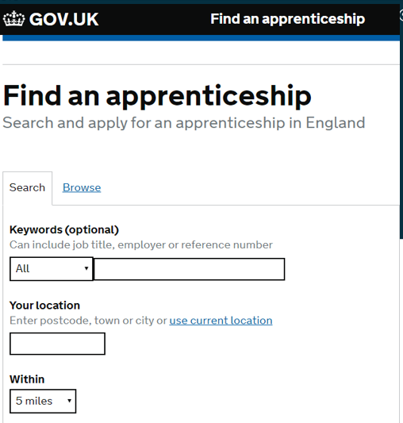
SEARCHING FOR VACANCIES

Slide 13
DEGREE APPRENTICESHIP APPLICATION PROCESS
1. CV/online application
Submitted directly to the employer
3. Test or in-tray exercise
Not widely used/for more senior roles
5. Interview
This could be either online or in person
2. Telephone interview
Used by employers to filter initial applications
4. Assessment centre
Held at the employer's offices or sometimes at the University
Notes:
**This is completely separate to UCAS** Applications are direct to employers, though we host all live vacancies and support with finding the jobs through our website and regular degree apprenticeship open evenings. We are linked with the employers quite closely and know when they are planning on hiring, they also tell us when they have completed their hiring process so we can begin to progress the university enrolments for new apprentices.

Slide 14
APPLYING FOR MANCHESTER MET
Step 1: Register
Receive direct alerts by entering your details at
Step 2: Look
Visit our website and employer websites
Peak vacancy time:
March - June
Step 3: Apply
Processes vary but usually involve a CV and cover letter or online application form. You may also have to attend an assessment centre and/or interview
mmu.ac.uk/study/apprenticeships
Notes:
Might not see many vacancies until the new year as our peak time is Feb-June . Bigger companies tend to hire earlier and have earlier deadlines.
Keep options open, apply to UCAS and meet the January UCAS deadline so you have university offers as a backup if you don’t manage to gain an apprenticeship from January onwards.

Slide 15
APPLYING FOR MANCHESTER MET
Step 4: Success
Congratulations! You’ve got the job. You’ll sign a contract with your new employer setting out the terms of the apprenticeship
Step 5: Enrol
Complete your university application and enrol onto your course. This usually takes places a few months before you start
Step 6: Begin
Apprenticeships usually start with an induction week, where you’ll get an introduction to the course and meet other apprentices
Notes:
Enrolment is an informal application where we take all your details and qualification information, we don’t make you do another full application to the university with personal statement etc.
Pending A level and BTEC results in August you will then begin on the programme in September or October with an induction week.

Slide 16
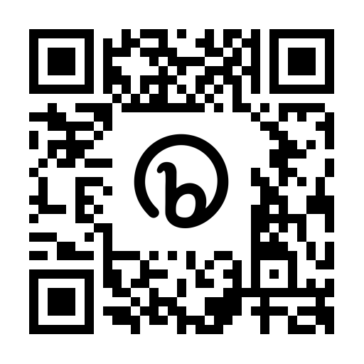
DEGREE APPRENTICESHIP EVENTS 2023
Festival of Apprenticeships
Tuesday 4th July 2023, 10-4pm Manchester Metropolitan University Business School
http://bit.ly/3nq8bKB

Slide 18
If you have any questions at all, you can contact our friendly team.
Good luck!
Sally Merrell
Student Recruitment Manager
Email: apprenticeships@mmu.ac.uk
Twitter: @MMUapprentice
Facebook: @MMUapprenticeships
Website: mmu.ac.uk/study/apprenticeships
VIRTUAL TOUR
Start your tour at
virtualexperience.mmu.ac.uk
CHAT TO A STUDENT
Start your conversation at
mmu.ac.uk/chatwithus
www.mmu.ac.uk

